Slide 1
Exploration of Negative Capacitance in Gate-All-Around Si Nanosheet Transistors
Presented by: Raahul L S[CB.EN.U4ECE22143] Dept. of Electronics and Communication Engineering, Amrita School of Engineering
Amrita Vishwa Vidyapeetham
Coimbatore

Slide 2
Introduction
a. Topic Overview:- The paper explores Negative Capacitance in Gate-All-Around (GAA) Nanosheet Transistors, a key innovation in semiconductor scaling. It addresses the growing need for energy-efficient and high-performance devices in IoT and advanced computing.
b. Problem Statement:- Traditional transistors like FinFETs face scalability, short-channel effects, and high power issues. This paper proposes integrating negative capacitance in GAA nanosheet transistors to overcome these challenges.
c. Objective:- To analyze and optimize NC-GAA nanosheet transistors for sub-60 mV/decade switching and benchmark their performance against existing architectures.
d. Motivation:- The demand for ultra-low power, compact, and scalable devices drives the need for NC-based transistors to meet industry and sustainability goals.

Slide 3
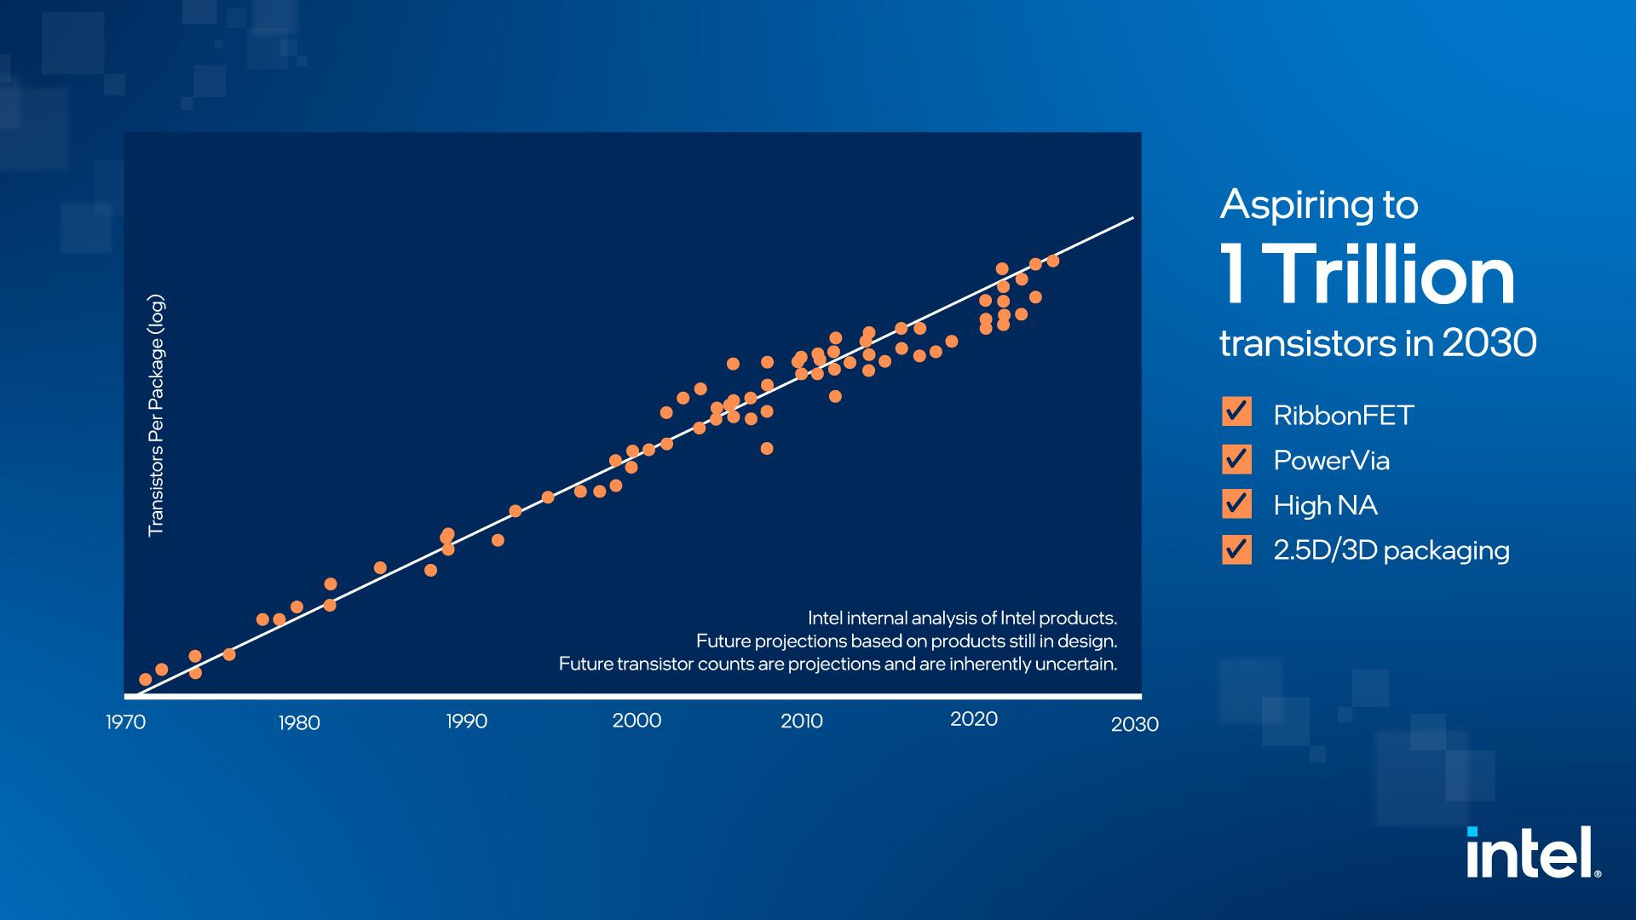
*Source : intel press kit

Slide 4
Problems in Scaling Down Transistor Size
Impact on Operating Voltage
Short-Channel Effects: Increased leakage and performance degradation.
Quantum Effects: Tunneling and reliability issues at nanoscale.
Heat Management: Higher density causes thermal challenges.
Fabrication Complexity: Advanced and expensive manufacturing processes.
Material Limits: Need for alternatives to silicon.
Variability: Greater process variations impact performance.
Interconnect Delays: Resistance and capacitance dominate signal propagation.
Gate Control: Poor control requires innovations like FinFETs and GAA transistors
Lower Supply Voltage: To reduce power and control leakage.
Reduced Threshold Voltage: Increases leakage and noise susceptibility.
Power Dissipation: Dynamic power decreases, but leakage power rises.
Reliability Issues: Lower noise margins lead to higher error risk.
Performance Trade-offs: Lower voltages reduce speed.
Signal Integrity: Harder to differentiate logic levels.

Slide 5
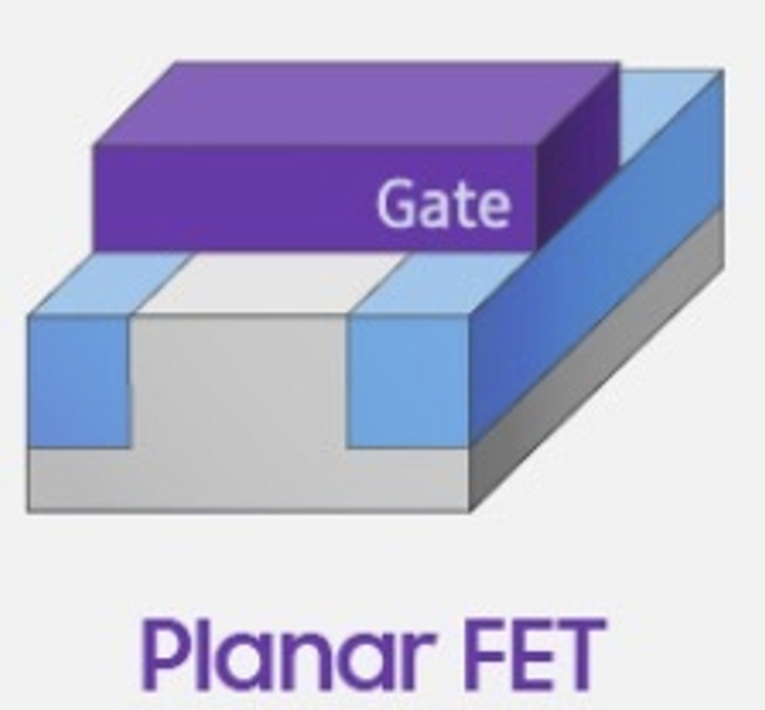
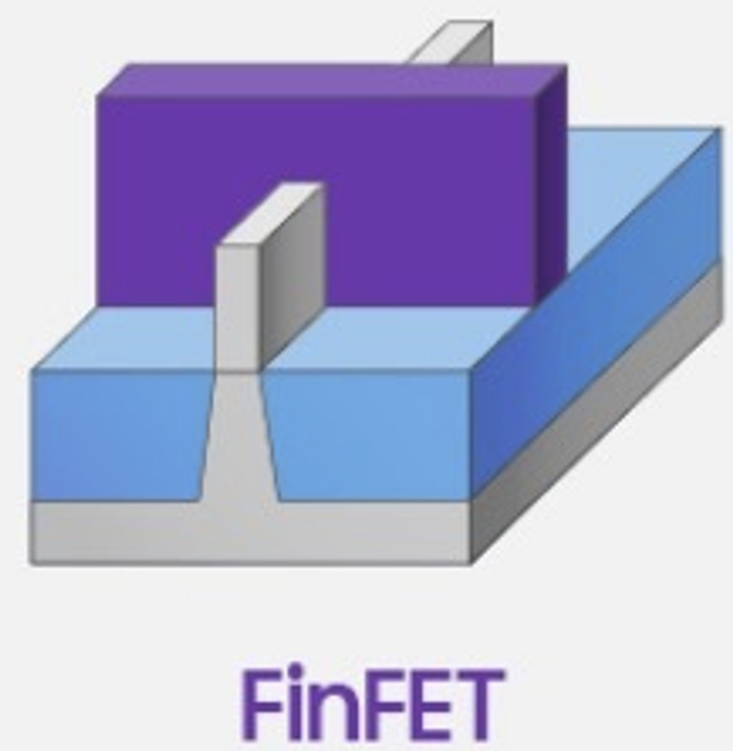
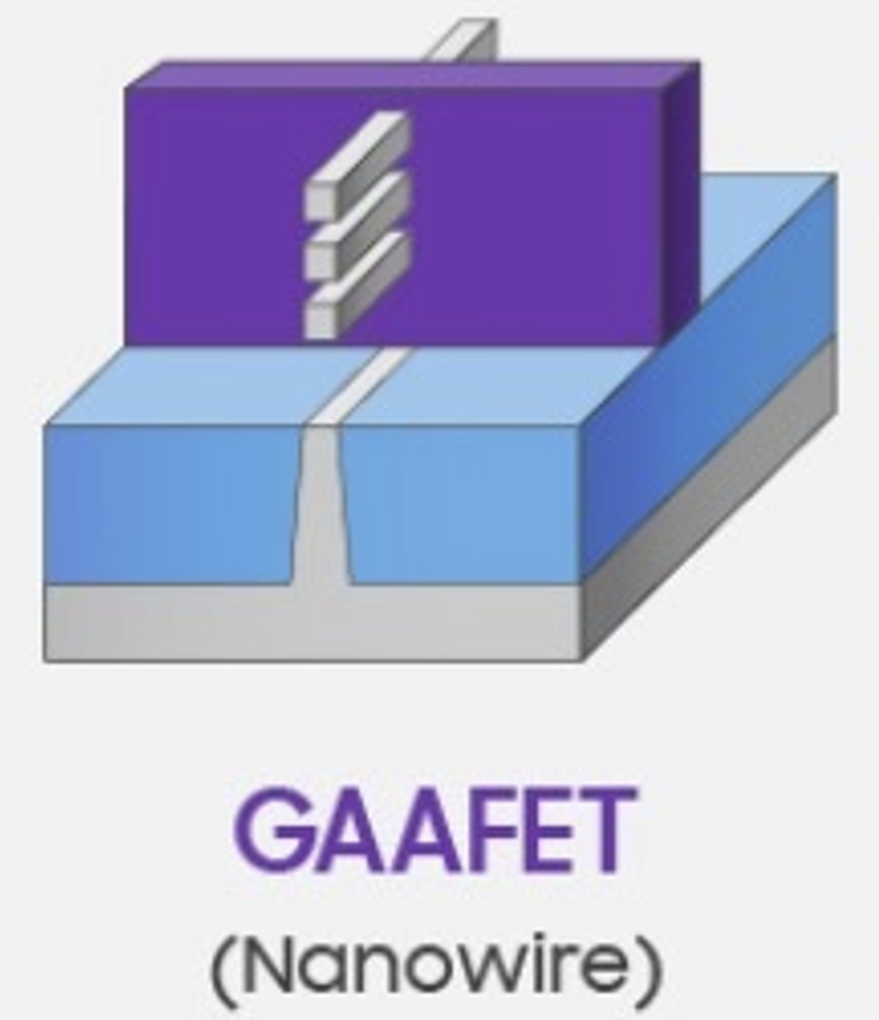
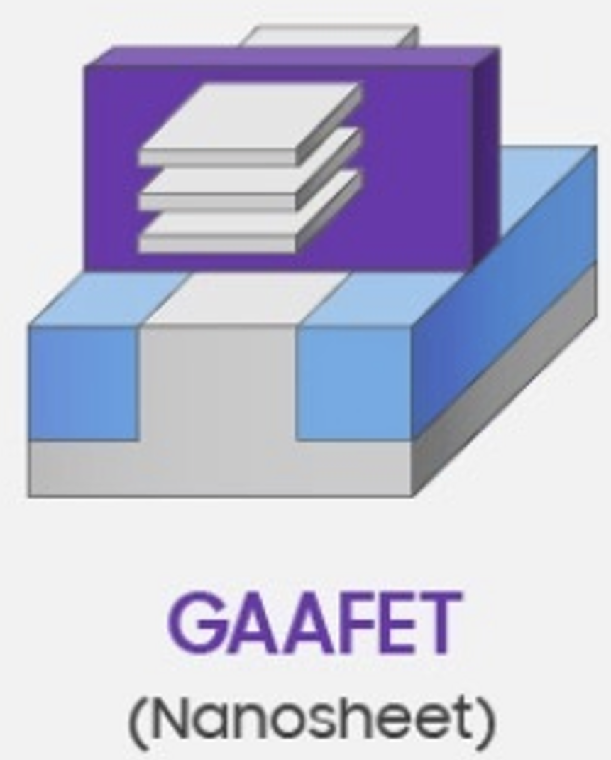
Feature | MOSFETs | FinFETs | Nanowire FETs (NWFETs) | Nanosheet FETs (NSFETs)
Advantages | - Simple planar design, easy to fabricate | - Improved gate control via 3D structure | - Ultimate gate control with GAA design | - Adjustable channel width for performance flexibility
 | - Low-cost manufacturing for larger nodes | - Reduced leakage and short-channel effects | - Minimal leakage and excellent electrostatic control | - Higher drive current due to wider 2D channels
 | - Mature and well-understood technology | - Higher drive current with multiple fins | - Suitable for sub-5nm nodes | - Better scalability for sub-3nm nodes
 |  | - Efficient at lower supply voltages | - High packing density due to compact 1D structure | - Lower variability and consistent performance
 |  | - Better performance at small nodes (7nm and below) | - Energy-efficient and operates at ultra-low voltages | - Retains excellent gate control from GAA architecture
Disadvantages | - Short-channel effects (e.g., DIBL, leakage) | - Manufacturing complexity and high costs | - Limited drive current due to narrow channels | - Requires advanced and expensive fabrication
 | - Poor gate control at smaller dimensions | - Limited scalability below 7nm due to fin pitch issues | - Fabrication challenges at nanoscale dimensions | - Increased manufacturing complexity for stacking layers
 | - High leakage currents at small nodes | - Increased parasitic capacitance in highly scaled nodes | - Variability in channel alignment | - Higher R&D and lithography costs
 | - Difficulty scaling below 22nm | - Non-uniformity in fin structures | - Performance limitations for wider applications | - Higher manufacturing costs than NWFETs

Slide 6
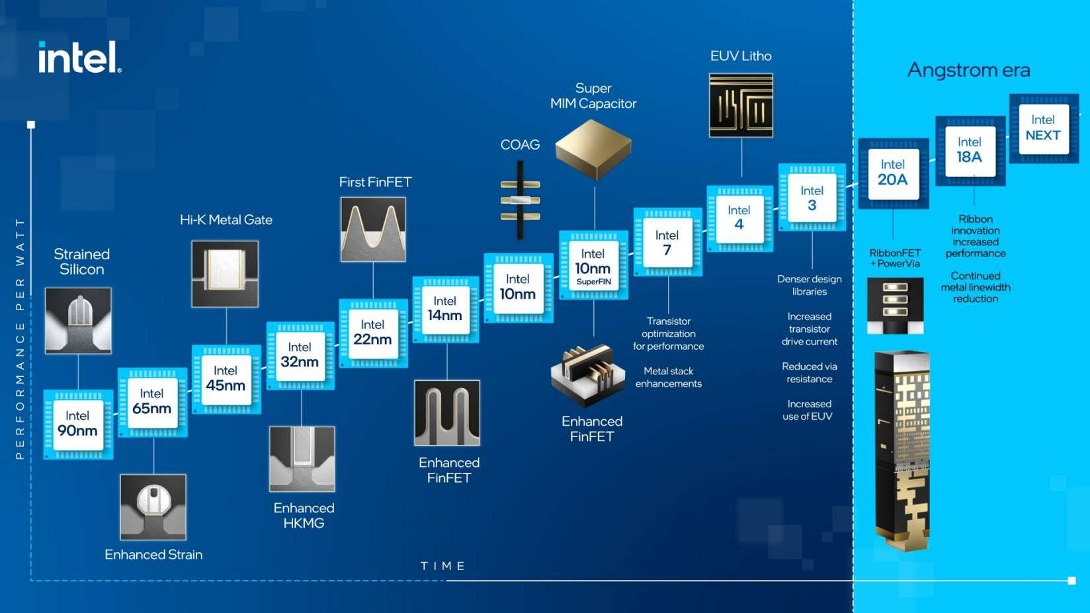
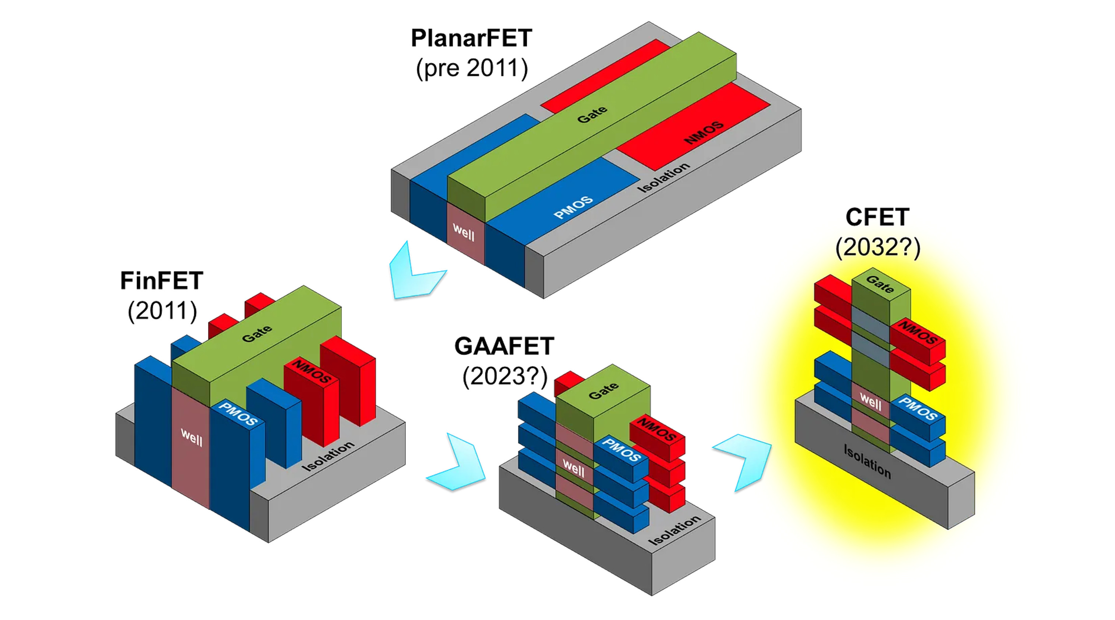
Current Industry Trends
Transition to Nanosheet FETs:
TSMC and Samsung are moving to nanosheet FETs for 3nm and beyond.
NSFETs dominate high-performance computing and mobile chip markets.
FinFETs Still Relevant:
Widely used for 7nm, 10nm, and 14nm nodes in cost-sensitive applications like IoT and consumer electronics.
Experimental Devices:
Research continues on advanced structures like Forksheet FETs and Carbon Nanotube FETs for future nodes (<2nm).
Usage in Electronics:
FinFETs: Common in CPUs, GPUs, and SoCs.
NSFETs: Emerging in high-end processors (e.g., mobile, AI, data centers).
NWFETs: Mostly experimental, with limited real-world application.
MOSFETs: Still prevalent in power electronics, analog circuits, and large-scale nodes (>28nm).
*Source : intel press kit

Slide 7
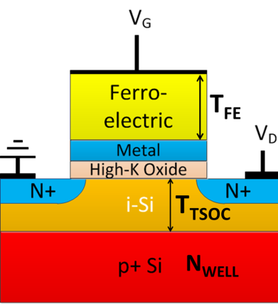
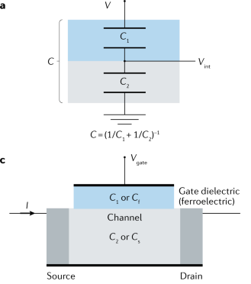
Negative capacitance
Boltzmann Limit
The Boltzmann limit refers to a fundamental thermodynamic constraint in traditional MOSFETs, which limits the subthreshold swing (SS) of a transistor to 60 mV/decade at room temperature (300 K). It arises due to the thermal distribution of carriers in the semiconductor.
Definition: NC is a phenomenon where a ferroelectric material amplifies the gate voltage in a transistor, resulting in sub-60 mV/decade switching.
Mechanism: Achieved by integrating a ferroelectric (FE) layer into the gate stack, creating internal voltage amplification.
Benefits:
Reduces power consumption by enabling voltage scaling.
Improves transistor switching speed and efficiency.
Enhances the Ion/Ioff ratio.
Applications: Ideal for low-power and high-speed devices in advanced technology nodes (sub-5nm).

Slide 8
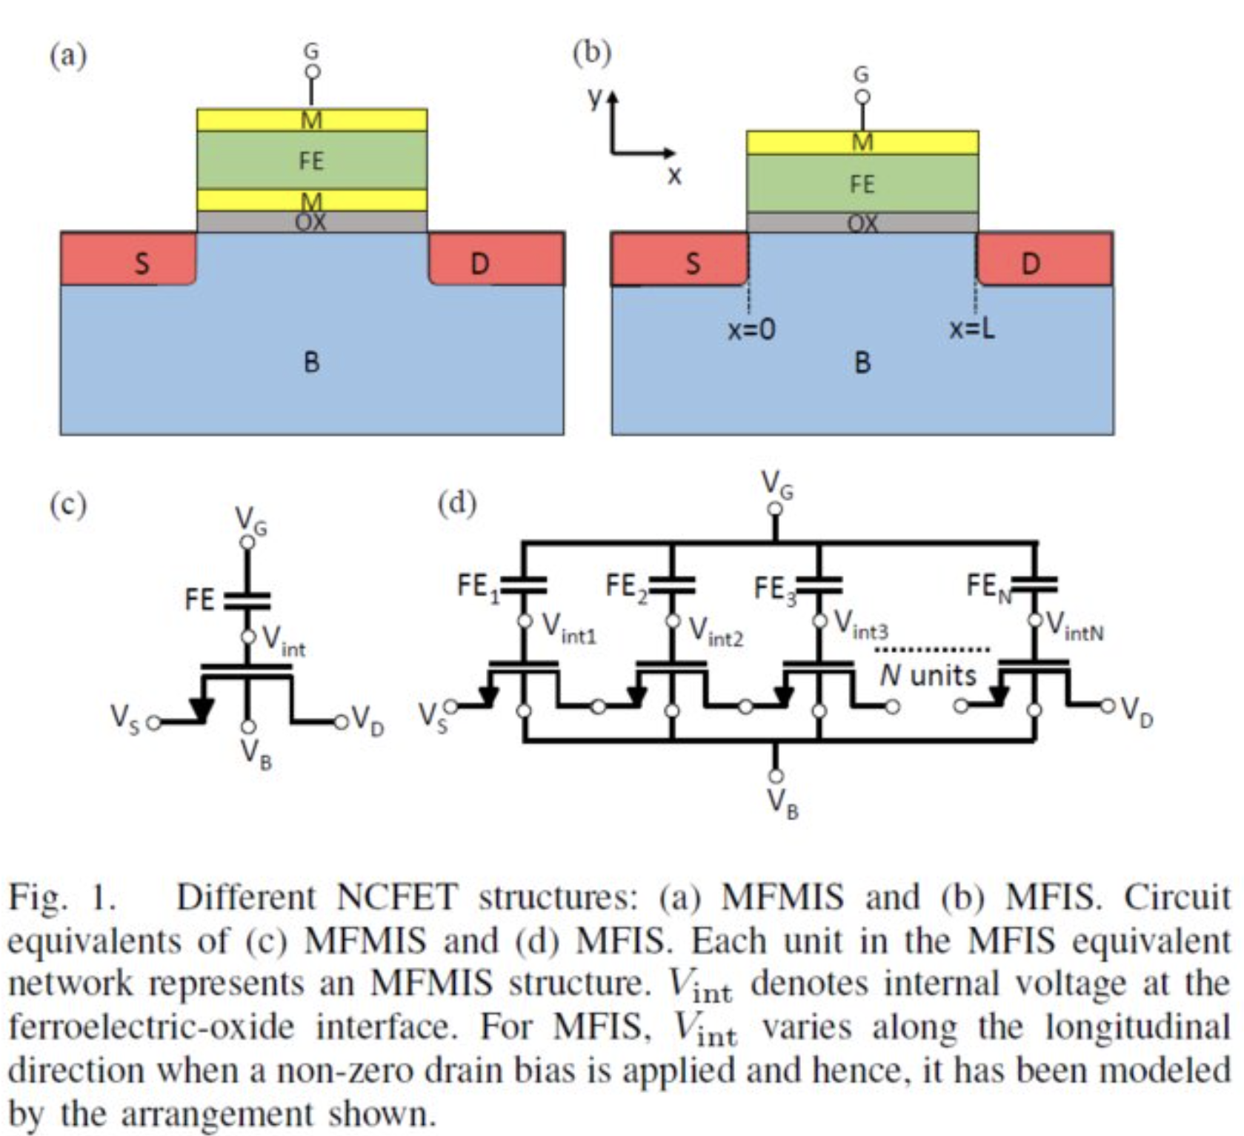
Feature | MFIS | MFMIS
Structure | Metal-Ferroelectric-Insulator-Semiconductor | Metal-Ferroelectric-Metal-Insulator-Semiconductor
Gate Design | Single metal gate in direct contact with the ferroelectric layer. | Metal layer separates the ferroelectric and the insulator.
Ferroelectric Polarization | Directly affects the semiconductor interface, leading to interface issues like charge trapping. | Buffered by the metal layer, improving stability and reducing interface issues.
Stability | Lower stability due to direct interaction of ferroelectric with the insulator/semiconductor. | Higher stability with improved ferroelectric behavior due to isolation by the metal layer.
Leakage Current | Higher leakage current due to direct contact between layers. | Lower leakage current as the intermediate metal layer acts as a barrier.
Complexity | Simpler structure but prone to degradation and reliability issues. | Slightly more complex structure but improved performance and reliability.
Capacitive Coupling | Weaker capacitive coupling due to direct ferroelectric-semiconductor interaction. | Stronger capacitive coupling due to the buffering metal layer.
Application | Used in early ferroelectric memory designs. | More advanced ferroelectric memory designs (e.g., FeFETs).
:
S

Slide 9
Literature review
Paper | Citation | Issue Handled | Base Idea | Strength | Limitation
Paper 1 | Singh, J., et al., "14-nm FinFET technology for analog and RF applications," IEEE Transactions on Electron Devices, vol. 65, no. 1, pp. 31-37, Jan. 2018. doi:10.1109/TED.2017.2776838 | Demonstrated the advantages of FinFET technology for analog and RF applications, highlighting its improved short-channel effects and scaling capabilities. | FinFETs provide excellent short-channel control and scalability for advanced nodes. | Superior performance in analog and RF domains with excellent scaling properties. | Challenges in further scaling beyond sub-10 nm nodes.
Paper 2 | Razavieh, A., Zeitzoff, P., and Nowak, E. J., "Challenges and limitations of CMOS scaling for FinFET and beyond architectures ," IEEE Transactions on Nanotechnology, vol. 18, no. 4, pp. 999-1004, Sep. 2019. doi:10.1109/TNANO.2019.2942456 | Highlighted the challenges of CMOS scaling for FinFETs, including process control and cost at advanced nodes. | CMOS scaling is becoming increasingly challenging for FinFET architectures. | Provides a comprehensive overview of the limitations of FinFET scaling. | Does not propose concrete solutions for overcoming scaling challenges.
Paper 3 | Loubet, N., et al., "Stacked nanosheet gate-all-around transistor to enable scaling beyond FinFET," in Proceedings of the IEEE Symposium on VLSI Technology, Jun. 2017, pp. 230-231. doi:10.23919/VLSIT.2017.7998183 | Proposed stacked nanosheet GAA transistors as a scalable alternative to FinFETs, offering improved electrostatics and short-channel control. | GAA nanosheet transistors provide a path forward for sub-10 nm nodes. | High scalability and excellent electrostatics. | Requires significant advancements in fabrication techniques.
Paper 4 | Nagy, D., et al., "FinFET versus gate-all-around nanowire FET: Performance, scaling, and variability," IEEE Journal of the Electron Devices Society, vol. 6, no. 1, pp. 332-340, Feb. 2018. doi:10.1109/JEDS.2018.2804383 | Compared FinFETs and GAA nanowire FETs, highlighting the latter's superior electrostatics and variability. | GAA nanowire FETs outperform FinFETs in electrostatics and scaling. | Demonstrates clear advantages in variability and gate control. | Limited drive current compared to nanosheet FETs.

Slide 10
Paper | Citation | Issue Handled | Base Idea | Strength | Limitation
Paper 5 | Barraud, S., et al., "Performance and design considerations for gate-all-around stacked-NanoWires FETs," in IEDM Technical Digest, Dec. 2017, p. 29. doi:10.1109/IEDM.2017.8268473 | Discussed performance and design considerations for GAA stacked nanowires. | GAA stacked nanowires improve performance through enhanced electrostatics. | Comprehensive analysis of design and performance factors. | Does not address challenges related to manufacturability.
Paper 6 | Jang, D., et al., "Device exploration of nanosheet transistors for Sub-7-nm technology node," IEEE Transactions on Electron Devices, vol. 64, no. 6, pp. 2707-2713, Jun. 2017. doi:10.1109/TED.2017.2695455 | Demonstrated the high drive current capability of nanosheet transistors due to their larger effective channel width compared to NWFETs. | Nanosheet FETs are superior in terms of drive current and scalability. | Excellent current drivability and scalability. | Increased parasitic capacitance compared to nanowire FETs.
Paper 7 | Salahuddin, S., and Datta, S., "Use of negative capacitance to provide voltage amplification for low power nanoscale devices," Nano Letters, vol. 8, no. 2, pp. 405-410, Feb. 2008. doi:10.1021/nl071804g | Introduced the concept of negative capacitance (NC) in FETs, enabling sub-60 mV/decade switching. | NC materials can amplify voltage and improve switching efficiency. | Provides a theoretical basis for NC-FETs. | Requires integration of ferroelectric materials, which poses fabrication challenges.
Paper 8 | Gaidhane, A. D., et al., "Compact modeling of drain current, charges, and capacitances in long-channel gate-all-around negative capacitance MFIS transistor," IEEE Transactions on Electron Devices, vol. 65, no. 5, pp. 2024-2032, May 2018. doi:10.1109/TED.2018.2813059 | Developed compact models for long-channel GAA-NCFETs, emphasizing their benefits for advanced nodes. | Compact modeling enables better understanding and optimization of GAA-NCFETs. | Supports simulation and design of advanced NC devices. | Focuses on long-channel devices, with limited applicability to short-channel effects.

Slide 11
Paper | Citation | Issue Handled | Base Idea | Strength | Limitation
Paper 9 | Lee, M. H., et al., "Extremely steep switch of negative-capacitance nanosheet GAA-FETs and FinFETs," in IEDM Technical Digest, Dec. 2018, p. 31. doi:10.1109/IEDM.2018.8614510 | Experimentally demonstrated steep switching in NC-GAA nanosheet FETs and compared their performance to FinFETs. | NC integration significantly improves switching characteristics in nanosheet FETs. | Provides experimental validation for NC-FET advantages. | Limited exploration of device stability and reliability.
Paper 10 | Pahwa, G., et al., "Numerical investigation of short-channel effects in negative capacitance MFIS and MFMIS transistors: Subthreshold behavior," IEEE Transactions on Electron Devices, vol. 65, no. 11, pp. 5130-5136, Nov. 2018. doi:10.1109/TED.2018.2870519 | Investigated short-channel effects in MFMIS and MFIS NCFETs, highlighting their subthreshold behavior. | Short-channel effects can be mitigated in NC-FETs through proper design. | Provides detailed insights into subthreshold behavior. | Does not address experimental challenges in achieving ideal NC effects.
Paper 11 | Zhou, J., et al., "Negative differential resistance in negative capacitance FETs," IEEE Electron Device Letters, vol. 39, no. 4, pp. 622-625, Apr. 2018. doi:10.1109/LED.2018.2810071 | Explored negative differential resistance (NDR) and its implications in NCFETs. | NDR can be utilized for novel device functionalities. | Highlights unique properties of NCFETs for analog applications. | Limited experimental validation of proposed NDR effects.
Paper 12 | Agarwal, H., et al., "Proposal for capacitance matching in negative capacitance field-effect transistors," IEEE Electron Device Letters, vol. 40, no. 3, pp. 463-466, Mar. 2019. doi:10.1109/LED.2019.2891540 | Proposed capacitance matching strategies for enhancing NC effects in NCFETs. | Proper capacitance matching enhances the performance of NC devices. | Provides actionable strategies for optimizing NC-FETs. | Does not address scalability challenges in capacitance matching.

Slide 12
Proposed methodology : Device Structure
The simulated devices are Negative Capacitance Field Effect Transistors (NCFETs) with an MFMIS (metal–ferroelectric–metal–insulator–semiconductor) gate stack configuration.
Aluminum-doped hafnium oxide (Al:HfO₂) is used as the ferroelectric (FE) material.
The metal work function (WF) is 4.65 eV.
Silicon nitride spacers (10 nm thick) are used to mitigate short-channel effects (SCE), although they are not shown in the diagram.
The channel is p-type doped (10¹⁶ cm⁻³), and the source/drain regions are n-doped (10²⁰ cm⁻³).

Slide 13
Proposed methodology :Stability Considerations
MFMIS NCFETs can face stability issues in steady state due to gate leakage through the FE layer.
Stability can be improved by engineering the work functions of the metals used in the external electrode and intermediate layer.
Gate leakage is deliberately ignored in this study to focus on performance trends, and MFMIS devices without gate leakage behave similarly to MFIS (metal–ferroelectric–insulator–semiconductor) devices.

Slide 14
Proposed methodology : Simulation Setup
Simulations were performed using the Silvaco Atlas device simulator, which solves Poisson’s and current continuity equations to calculate gate charge (QG) and drain current (ID) as functions of gate voltage (VG).
The ferroelectric capacitor is modeled using the 1-D Landau–Khalatnikov (L–K) equation.
Bulk material parameters for the FE material:
α = −3 × 10⁻⁹ m/F, β = 6 × 10¹¹ m⁵/C²F, and γ = 0.
Quantum confinement effects are modeled using the Bohm Quantum Potential (BQP) model.
The Lombardi mobility model is used to account for mobility degradation due to phonon and Coulomb scattering.

Slide 15
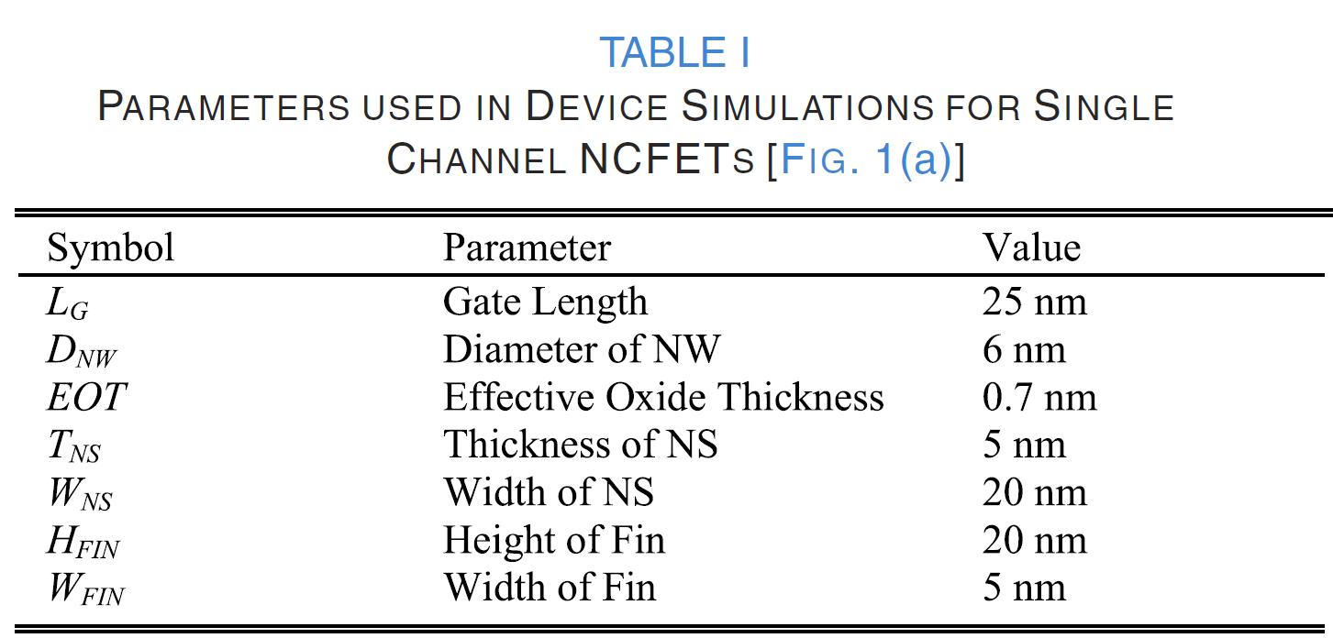
Performance analysis :
Devices evaluated: MFMIS NC-NWFET, NC-NSFET, NC-FinFET, and their baseline counterparts.
Comparable device dimensions and doping profiles were used.
Simulations utilized parameters listed in Table I.

Slide 16
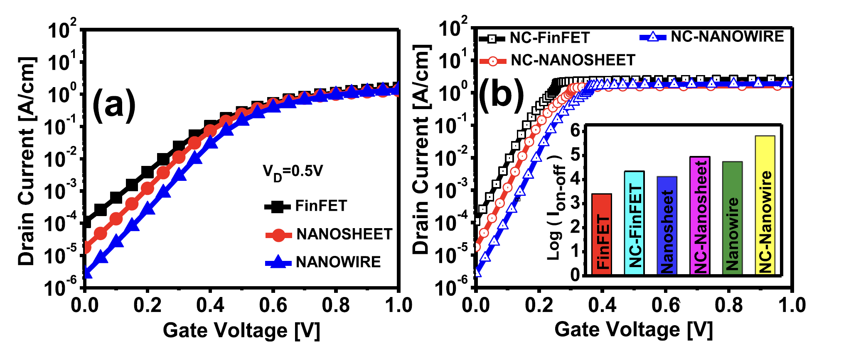
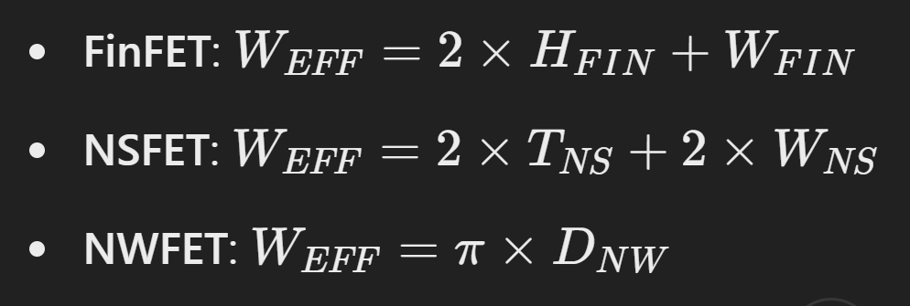
Performance analysis : Transfer Characteristics
Baseline transfer characteristics shown in Fig. 3(a); NC device characteristics in Fig. 3(b).
Ion/Ioff Ratio:
NC effect enhances Ion/Ioff ratio for all NCFETs.
Cylindrical NWFET has the lowest Ioff, resulting in the best Ion/Ioff ratio, followed by NSFETs.
Subthreshold Swing (SS):
Cylindrical NWFET exhibits the smallest SS due to excellent electrostatic gate control via GAA structures.
Notes:
TFE Adjustment: TFE for each NCFET structure is optimized to avoid hysteresis.Fair Comparison:Normalization: IDI_DID​ for each single-channel device is normalized by its effective gate width (WEFFW_{EFF}WEFF​).
Equal IONI_{ON}ION​: IONI_{ON}ION​ is made nearly equal across different geometries for a fair comparison.
plots the
Ion/Ioff ratio for both the baseline and their NC counterparts.
Ion enhancement due to the NC effect results in higher Ion/Ioff
ratio in all NCFETs.
NWFET has the lowest OFF current, Ioff , thereby,
offering the best Ion/Ioff ratio, followed by NSFETs.
excellent electrostatic gate control provided by the surrounding GAA structures, which also leads
to smallest subthreshold swing (SS) in these devices.

Slide 17
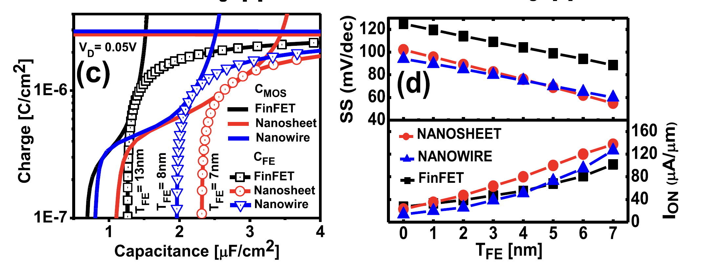
Capacitance Matching and NC Effect
NC effect arises when the negative FE capacitance (CFE < 0) and positive CMOS capacitance are combined.
Maximum NC effect achieved when CFE is closely matched to CMOS (-CFE = CMOS).
Thicker FE layers increase NC effect but may induce hysteresis.
Capacitance matching:
NC-NSFET achieves matching with TFE = 7 nm (lowest among devices).
NC-NWFET and NC-FinFET match at TFE = 8 nm and 13 nm, respectively.

Slide 18
Performance analysis
Hysteresis:
Thinner FE layers reduce hysteresis, crucial for scaling NCFETs in advanced technology nodes.
NC-NSFET operates hysteresis-free at TFE = 7 nm.
Device Comparison at TFE = 7 nm:
NC-NSFET:
38% lower SS than NC-FinFET.
9% lower SS than NC-NWFET.
35% higher Ion than NC-FinFET.
SS and Ion Trends:
Higher TFE improves NC performance (lower SS and higher Ion).
Maximum TFE limited to 7 nm for all devices to avoid hysteresis.

Slide 19
Single Stack vs. Double Stack NC-NSFET
Single Stack NC-NSFET:
Structure:
Contains three stacked nanosheet (NS) channels.
Effective Gate Width (Wₑₓₑₓ):
Wₑₓₑₓ = 3 × (2 × Wₙₛ + 2 × Tₙₛ).
Key Characteristics:
At Lₓ = 80 nm, each NS in a single stack is 2.5× wider than in a double stack.
Achieves up to 25% more Iₒₙ than the double stack.
Provides lower Subthreshold Swing (SS): 13% lower at VDD = 0.7 V.
Offers a similar Iₒₙ/Iₒₑₓ ratio compared to the double stack.

Slide 20
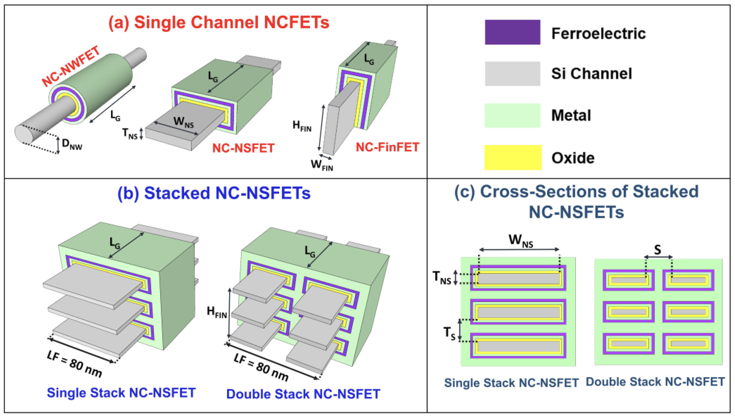
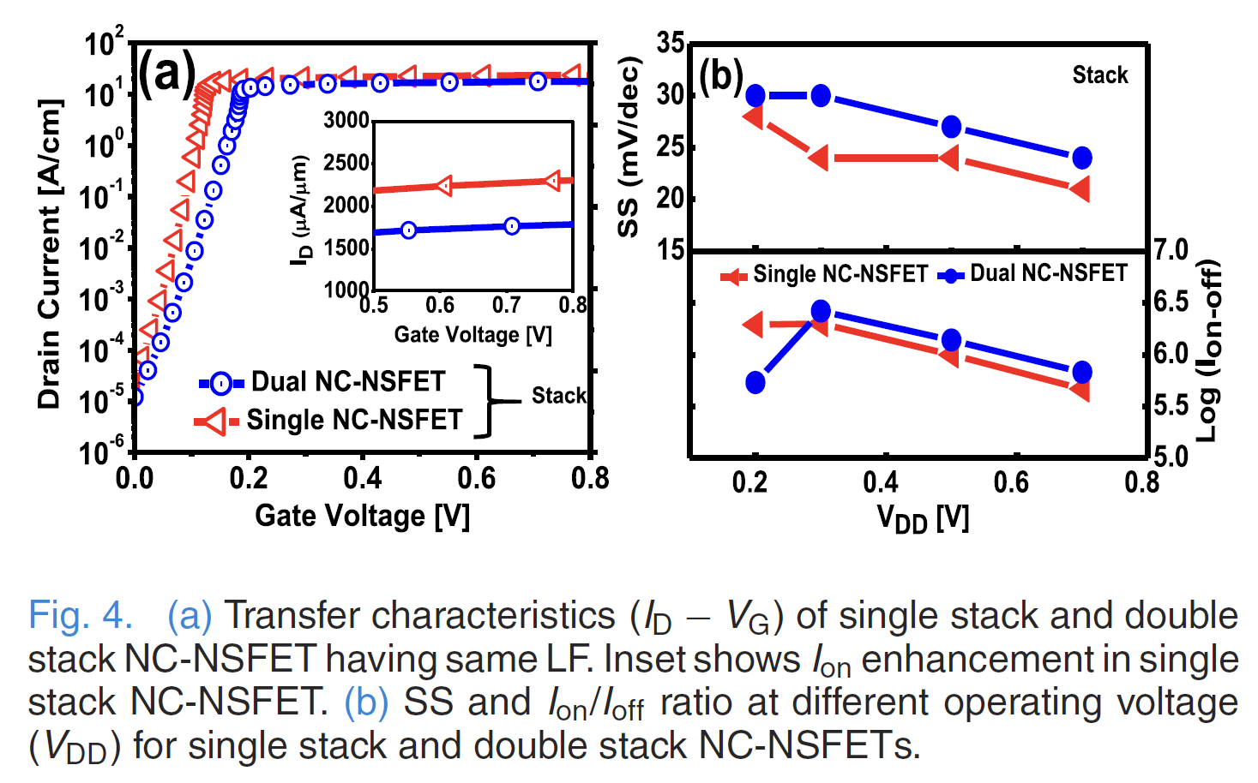
Single Stack vs. Double Stack NC-NSFET
Double Stack NC-NSFET:
Structure:
Composed of two single-stack columns.
Effective Gate Width (Wₑₓₑₓ):
Wₑₓₑₓ = 6 × (2 × Wₙₛ + 2 × Tₙₛ).
Key Characteristics:
Requires higher V₉ for channel inversion.
Slightly better gate control compared to a single stack.
Marginal improvement in the Iₒₙ/Iₒₑₓ ratio at higher VDD.

Slide 21
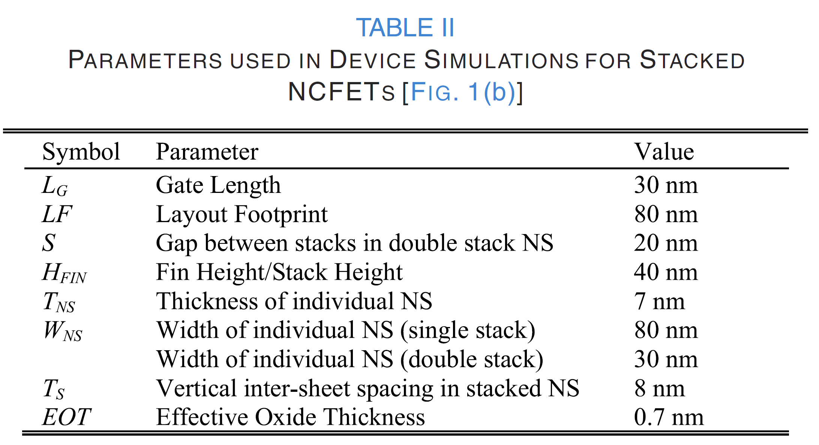
Performance analysis : Stacked NC-NSFET Devices
Advantages of GAA Stacked NSFETs:
Superior performance compared to single-channel devices.
Higher effective gate width (Wₑₓₑₓ) increases Iₒₙ.
Adding more stacked channels further enhances Iₒₙ.
Single Stack NC-NSFET:
Higher Iₒₙ, lower SS, and similar Iₒₙ/Iₒₑₓ ratio compared to a double stack.
Double Stack NC-NSFET:
Slightly better gate control but requires higher V₉ and shows marginal Iₒₙ/Iₒₑₓ improvements.
Conclusion
Due to its superior Iₒₙ, lower SS, and comparable Iₒₙ/Iₒₑₓ ratio, only single stack NC-NSFET devices are considered for further analysis.

Slide 22
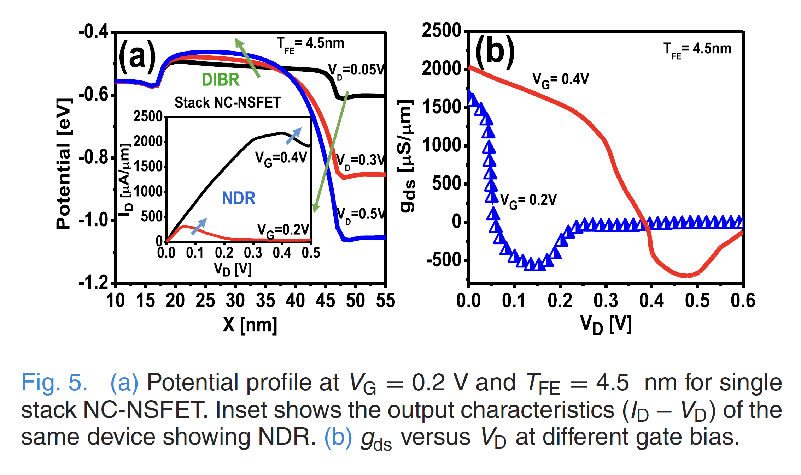
DIBR and Negative Differential Resistance Characteristics
Phenomena in NCFETs
Negative Drain-Induced Barrier Lowering (N-DIBL):
Unlike conventional MOSFETs, the potential barrier rises with increasing V_{D}​, leading to Drain-Induced Barrier Rising (DIBR) behavior.
This behavior reduces I_{D}with increasing V_{D}​, causing Negative Differential Resistance (NDR).
Negative Differential Resistance (NDR):
I_{D}decreases with increasing V_{D}.
NDR is influenced by differential gain (Aᵥ) and gate-drain coupling factor (ηₓGD), which affect the internal node voltage (Vᵢₙₜ).

Slide 23
Device Tuning
Impact of T_{FE}:
T_{FE} influences C_{FE}, which directly affects DIBR and NDR.
A thicker T_{FE}
- Lowers subthreshold swing (SS).
- Enhances NDR, potentially causing hysteresis.
Output Conductance (g_ds):
Defined as g_ds = ΔI_D / ΔV_D.
g_ds depends on V_D, V_G, and TFET_FE (T_FE).
- Negative g_ds: Indicates a strong NDR effect.
- Positive g_ds: Achieved by engineering asymmetric source/drain parasitic capacitances.

Slide 24
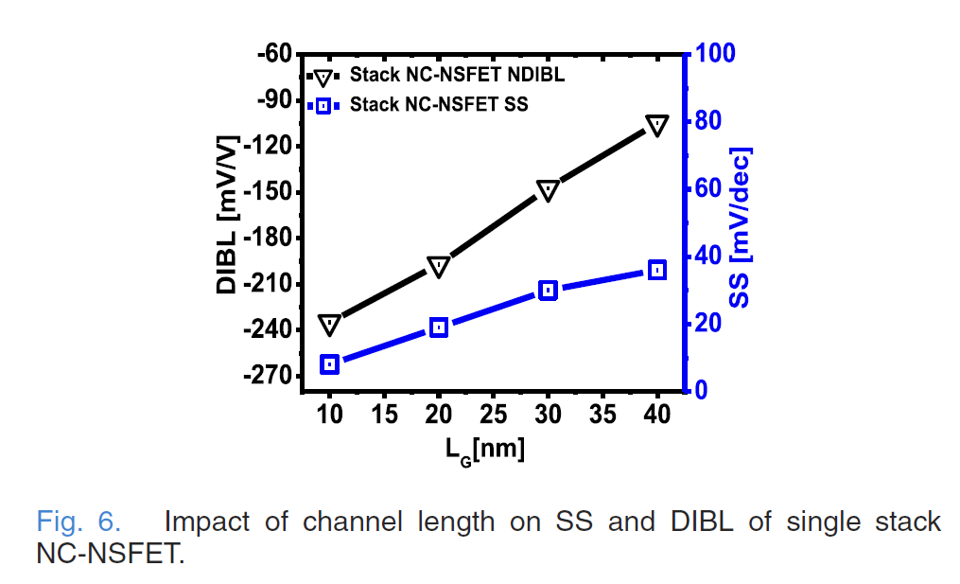
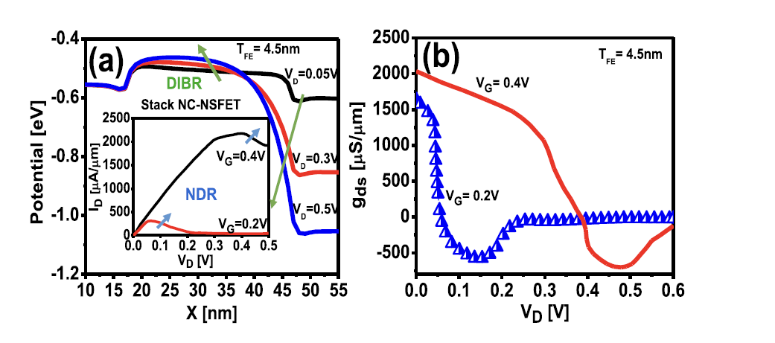
Observations from Figures
Fig. 5(a):
Shows the potential profile for single stack NC-NSFET at V_G = 0.2 V and T_FE = 4.5 nm.
Inset: Output characteristics (I_D vs. V_D) display NDR behavior.
Fig. 5(b):
Plots g_ds versus V_D at two gate biases for T_FE = 4.5 nm.
Negative g_ds shifts to higher V_D with increased gate bias.
Fig. 6:
Illustrates SS and DIBL improvements with L_G scaling for a device with three nanosheets, each 7 nm × 80 nm in size.
Summary:
- NCFETs exhibit DIBL and NDR, which can be tuned by T_FE and other device parameters.
- Scaling L_G improves SS and DIBL due to enhanced differential gain.
- NDR can be mitigated or enhanced by engineering device capacitances and parasitics.

Slide 25
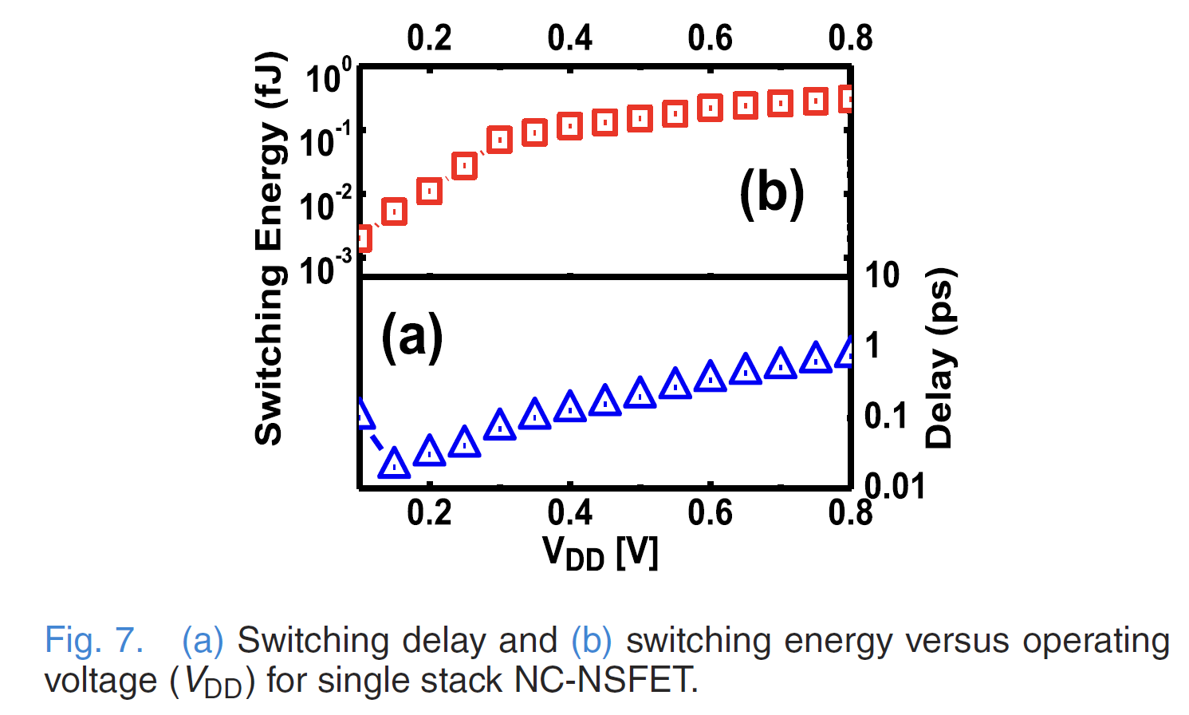
Switching Delay and Energy in Single Stack NC-NSFET
Switching Delay:
Formula: Delay = C_inv ⋅ V_DD / I_on = ΔQ_G / I_on
Depends on inversion capacitance (C_inv), differential gate charge (ΔQ_G), and on-current (I_on).
Switching Energy:
Formula: Energy = ΔQ_G ⋅ V_DD
Differential Gate Charge (ΔQ_G):
ΔQ_G = Q_G(V_GS = V_DD) − Q_G(V_GS = 0)
Performance Insights:
- Larger W_EFF in NC-NSFETs leads to higher I_on and faster switching.
- Faster switching compared to NC-FinFETs and NC-NWFETs of similar dimensions.
Effect of Operating Voltage:
- Higher V_DD increases ΔQ_G, resulting in longer delays and higher energy consumption.

Slide 26
Performance of NC-NSFETs Based on NS Dimensions
Key Parameters:
- Width (W_NS) and Thickness (T_NS) of the nanosheet (NS) significantly affect drive current and performance.
Transfer Characteristics (I_D-V_G):
- For thinner NS (T_NS decreases from 5 nm to 3 nm, W_NS = 20 nm):
- Both I_on and I_off decrease.
- Reasons:
- Increased effective bandgap
- Enhanced barrier height
- Reduced density of states
- Mobility degradation
- Increased perpendicular electric field
- Thinner NS requires a higher V_G for saturation current.
- Adding the FE layer compensates for the reduced I_on, improving the I_on/I_off ratio.

Slide 27
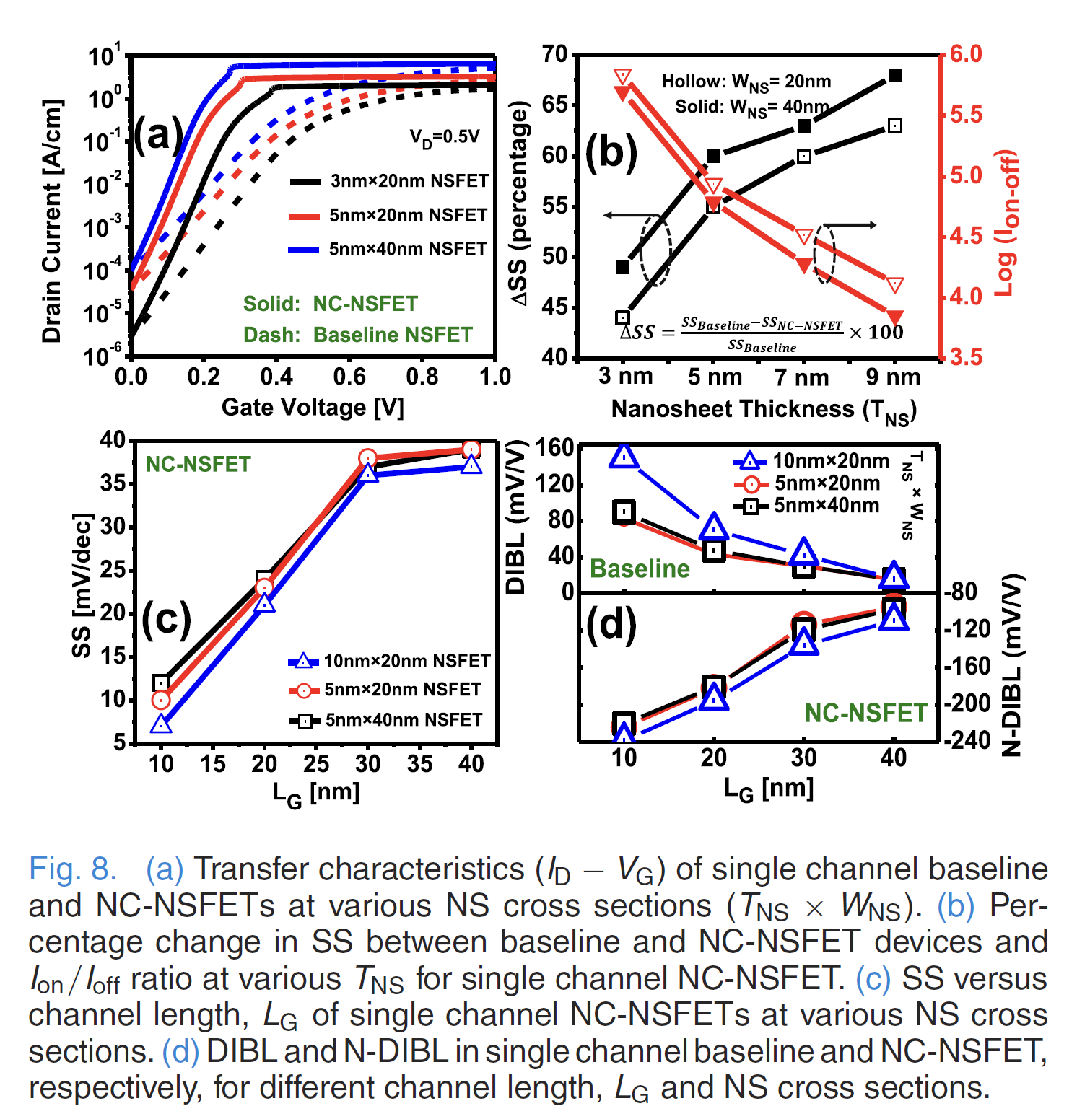
Performance of NC-NSFETs Based on NS Dimensions
Effect of NS Dimensions on I_on/I_off:
- Wider NS (W_NS = 40 nm) leads to:
- Higher I_on and I_off.
- Slightly reduced I_on/I_off due to degraded gate control.
Subthreshold Swing (SS):
- Improvement in SS (ΔSS) decreases with thinner NS:
- Example: With W_NS = 20 nm, ΔSS drops from ~60% (at T_NS = 7 nm) to ~44% (at T_NS = 3 nm).
- Quantum effects across T_NS are more significant than across W_NS.
SS - Reduces with decreasing channel length (L_G) in NC-NSFETs.
SS - Invariant with T_NS and W_NS.
DIBL and N-DIBL - Baseline NSFETs: DIBL increases with T_NS × W_NS.
DIBL and N-DIBL - NC-NSFETs: N-DIBL becomes more negative with increasing NS dimensions due to increased drain coupling.

Slide 28
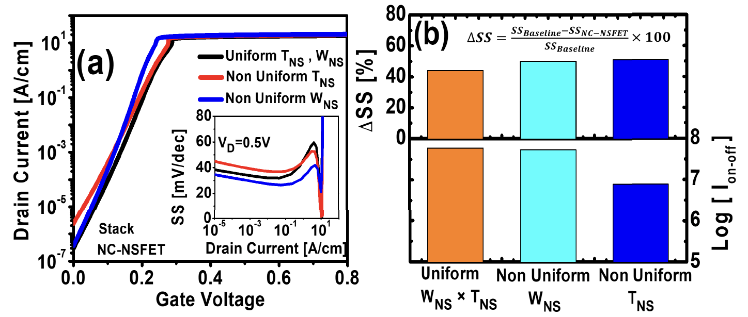
Nonuniformity in Stacked Nanosheets (NSs)
Variations in NS dimensions (width W_{NS} and thickness T_{NS}) affect capacitance matching and the NC effect in stacked NC-NSFETs. Nonuniform NSs within a stack result in differences in subthreshold swing (SS) and Ion/I_{off} ratio.
SS Behavior:
Stacks with nonuniform W_{NS} show lower SS compared to those with uniform W_{NS} and T_{NS}. The trend reverses for stacks with nonuniform T_{NS}.
Performance Metrics:
Nonuniform stacks (W_{NS} and T_{NS}) offer ~5% higher ΔSS due to the NC boost compensating for performance degradation caused by nonuniformity.
Leakage current degrades in stacks with nonuniform T_{NS}, reducing the Ion/Ioff ratio.

Slide 29
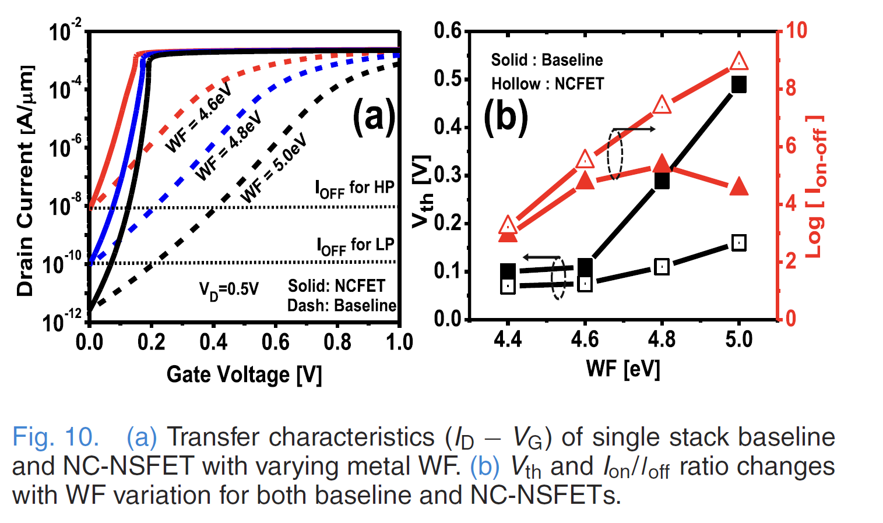
Metal Work Function (WF) Variation
Threshold Voltage (Vth) and Work Function (WF)
Metal WF variations (4.6-5.0 eV) in NC-NSFETs allow for tuning of Vth, enabling multi-Vth solutions.
Key Benefits:
- NC-NSFETs maintain low Vth even at higher WF values (e.g., Vth = 0.15V at WF = 5.0 eV)
- Improved Ion/Ioff ratio with higher WF in NC-NSFETs
- Suitable for high-performance (HP), low-power (LP), and ultra-low-power (ULP) applications
Design Freedom:- NC-NSFETs with tunable WF enable voltage scaling and meet OFF-state requirements for various applications without compromising performance.

Slide 30
Sustainability & Ethical analysis
Enables ultra-low power consumption, reducing energy demand.
Supports device scaling, minimizing material usage.
Extends device life, delaying electronic waste generation.
Complex fabrication may increase resource and energy usage.
High costs may exacerbate the digital divide.
Manufacturing must minimize environmental harm and waste.
Ensure transparency and collaboration in research.
Prioritize worker safety in advanced fabrication processes.

Slide 31
Conclusion
A comprehensive study of NC-NSFETs has been conducted using fully calibrated 3-D TCAD simulations.
Subthreshold Swing (SS):- Single-channel NC-NSFETs demonstrate significantly lower SS ( 9% compared to NC-NWFET and 38% compared to NC-FinFET) for similar device dimensions.
Capacitance Matching:- Effective matching between ferroelectric (FE) and MOS capacitances enables hysteresis-free operation, even with thinner FE layers, facilitating ultrascaling of NC-NSFETs.
Stack Performance:- Single-stack NC-NSFETs outperform double-stack counterparts in terms of Ion​, SS, and faster switching characteristics at low VDD​.
N-DIBL and NDR:- N-DIBL and associated negative differential resistance (NDR) behavior have been analyzed with varying gate lengths (L_{G}​) in single-stack NC-NSFETs.
Impact of Key Design Parameters:
Variations in NS dimensions T_{NS}​ and W_{NS} and metal work function (WF) influence device performance.
Thinner NSs yield superior performance, while W_{NS}​ must be optimized based on design requirements.
Tuning the metal WF significantly improves leakage current and Ion/Ioff​ ratio.

Slide 32
Future Works
Explore process variation mitigation techniques to reduce nonuniformity in NS dimensions within stacks.
Investigate scaling opportunities for NC-NSFETs beyond the 5-nm technology node.
Optimize ferroelectric layer thickness for achieving hysteresis-free operation in multi-stack configurations.
Extend studies on negative capacitance effects in different transistor architectures (e.g., gate-all-around devices).
Develop models for reliability analysis under practical operating conditions, including thermal and electrical stress.
Assess NC-NSFETs' suitability for emerging low-power applications, such as IoT and edge computing.
Analyze the integration of NC-NSFETs with advanced materials, such as 2D semiconductors, for ultra-scaled devices.

Slide 33
References
T. S. Perry, "The father of FinFets: Chenming Hu took transistors into the third dimension to save Moore's Law," in IEEE Spectrum, vol. 57, no. 5, pp. 46-51, May 2020, doi: 10.1109/MSPEC.2020.9078456.
J. Singh et al., “14-nm FinFET technology for analog and RF applications,”IEEE Trans. Electron Devices, vol. 65, no. 1, pp. 31–37, Jan. 2018, doi: 10.1109/TED.2017.2776838.
A. Razavieh, P. Zeitzoff, and E. J. Nowak, “Challenges and limitations of CMOS scaling for FinFET and beyond architectures,” IEEE Trans. Nanotechnol., vol. 18, no. 4, pp. 999–1004, Sep. 2019, doi: 10.1109/TNANO.2019.2942456.
A. I. Rahman, A. S. Naqvi, A. A. Reza, and A. A. Farid, "Progress and Future Prospects of Negative Capacitance Devices," Appl. Phys. Rev., vol. 9, no. 2, p. 020902, Feb. 2022.
A. I. Rahman, A. S. Naqvi, A. A. Reza, and A. A. Farid, "Progress and Future Prospects of Negative Capacitance Devices," Appl. Phys. Rev., vol. 9, no. 2, p. 020902, Feb. 2022.

Slide 34

References
M. A. Khan, J. K. Lee, and P. Kumar, "From MOSFET to FinFET to GAAFET: The Evolution, Challenges, and Future Prospects," ResearchGate, 2023.
R. S. Lee, J. M. Kim, and Y. Park, "Highly Selective Chemical Sensor Using Graphene Oxide," Nano Lett., vol. 7, no. 9, pp. 2711–2718, Sep. 2007.
A. Das, B. Roy, and P. Pal, "Physical Insights on Negative Capacitance Transistors in Non-Hysteresis and Hysteresis Regimes: MFMIS vs MFIS Structures," ResearchGate, 2017.
V. Chauhan and D. P. Samajdar, "Recent Advances in Negative Capacitance FinFETs for Low-Power Applications: A Review," IEEE Transactions on Ultrasonics, Ferroelectrics, and Frequency Control, vol. 68, no. 10, pp. 3056–3068, Oct. 2021, doi: 10.1109/TUFFC.2021.3095616.
H. Agarwal et al., “Engineering negative differential resistance in NCFETs for analog applications,” IEEE Trans. Electron Devices, vol. 65, no. 5, pp. 2033–2039, May 2018, doi: 10.1109/TED.2018.2817238.

